Slide 1

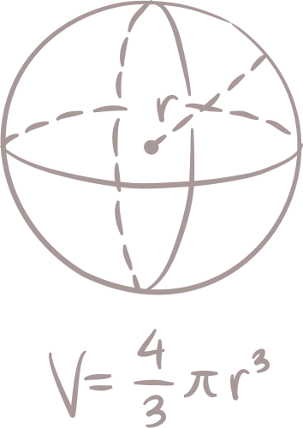

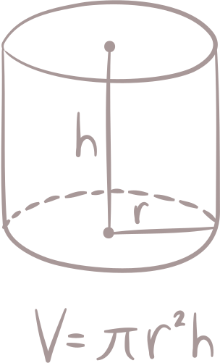

Ordinary Differential Equation - Boundary Value Problems
Start Now

Slide 2

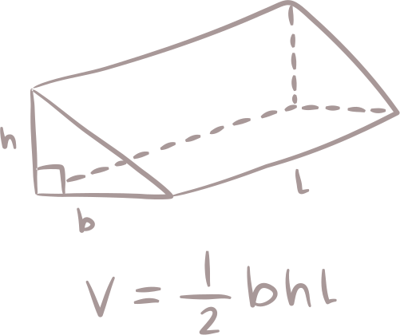
Group 10:
Ian (24083010090)
Olive (24083010120)
Alysha (24083010123)

Slide 3
Table of COntents
ODE Boundary Value Problem Statement
The Shooting Method
Finite Difference Method
Solution for Shooting
Solution for Finite Diff.

Slide 4
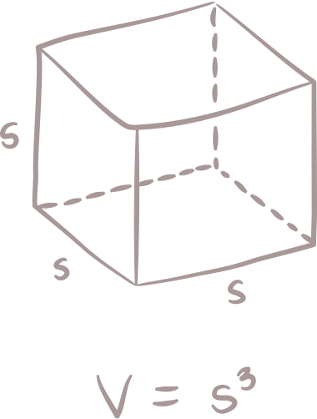

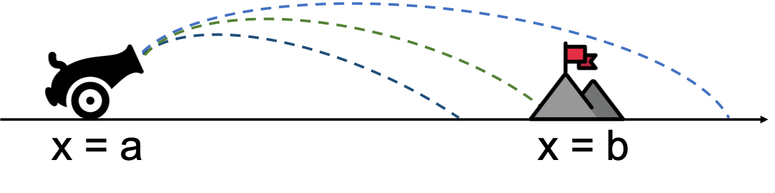
ODE Boundary Value Problem Statement

Slide 5

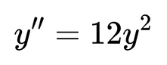
What is an ODE?
Ordinary Differential Equation (ODE) describes how a quantity changes with respect to another (e.g., temperature, position, etc.).
Used in science & engineering for modeling real systems.
An n-th order ODE requires n constraints.
Example: A 2nd order ODE (like ) requires 2 constraints (e.g., y(0)=4 and y(5)=50).

Slide 6

IVP vs BVP
Initial Value Problem (IVP)
Given start point only (e.g., position & direction at x = 0).
Boundary Value Problem (BVP)
Values are known at two or more boundaries (e.g., T at x = 0 and x = L).

Slide 7
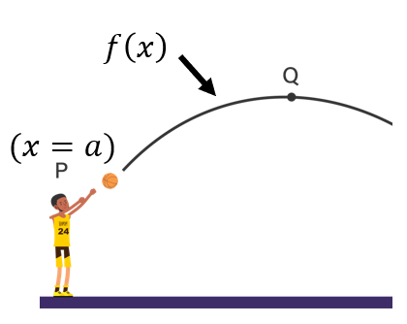
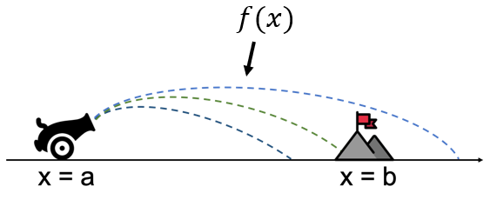
IVP vs BVP
Initial Value Problem (IVP)
Known initial position and direction, find the entire path.
Boundary Value Problem (BVP)
Known values at both boundaries, find the shape/function in between.

Slide 8




Why is BVP Important?
Many real problems depend on conditions at more than one point.
Used in thermal engineering, mechanics, electrical circuits, etc.

Slide 9
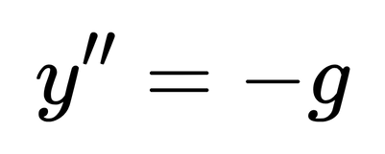
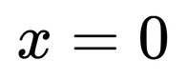
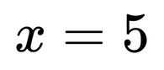
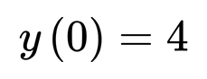
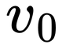
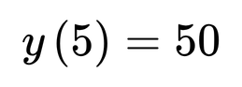
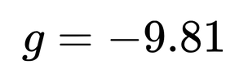
Real-World Example:
cannon Trajectory Problem
Problem:
A cannon is launched from position and must hit a target at .
Given:
Initial position:
Target position:
Gravity:
Mathematical Model:
Find:
Initial vertical rocket speed ( ) that satisfies the ODE and both boundary conditions.

Slide 10
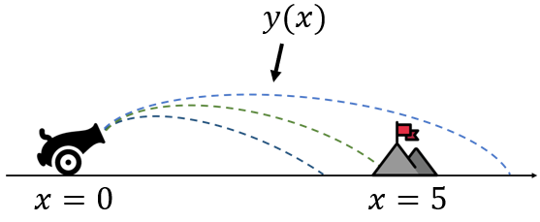
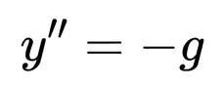
Real-World Example:
cannon Trajectory Problem
Legend:
: Initial height at launch
: Target height at destination
: Equation governing the trajectory

Slide 11
The shooting methode

Slide 12
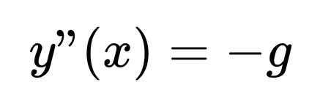
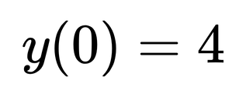
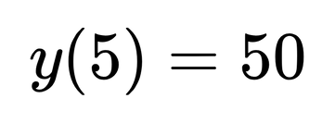
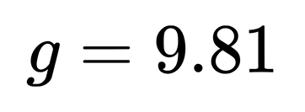
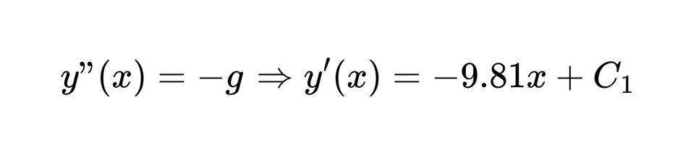
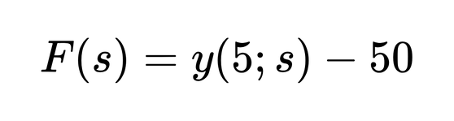
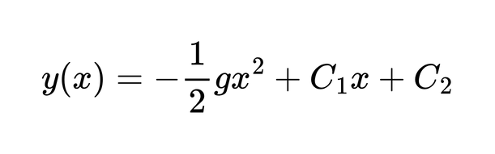
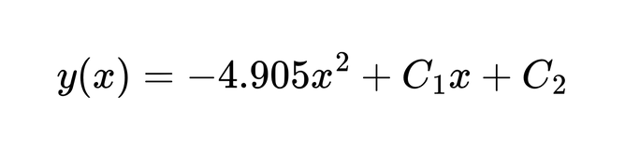
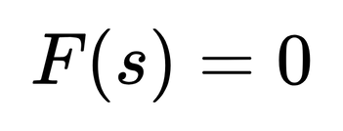
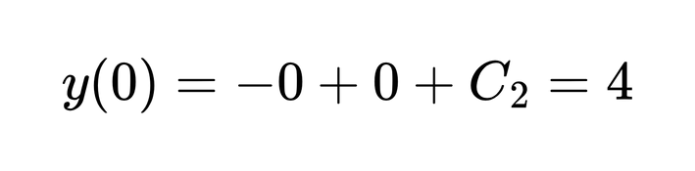
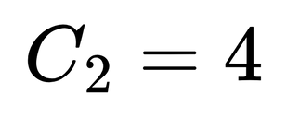
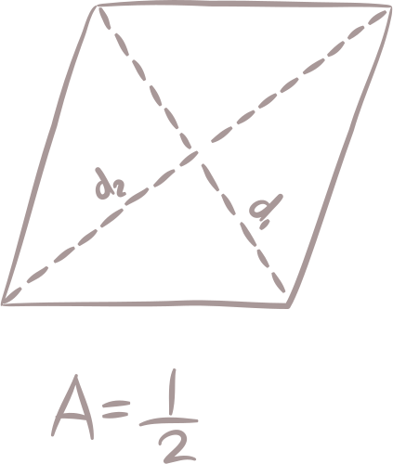
The Shooting Method
Solve the BVP:
General IVP solution
Error Function:
Results (RK4 + Secant shooting)
Adjust s:
Apply boundary condition at x = 0

Slide 13

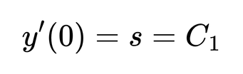
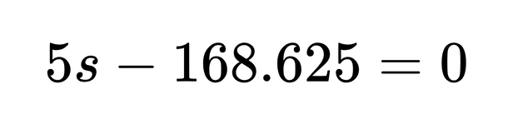
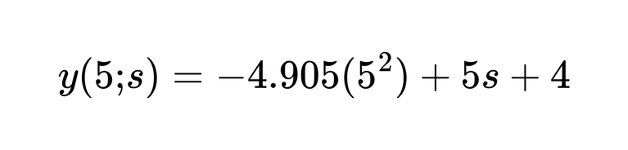
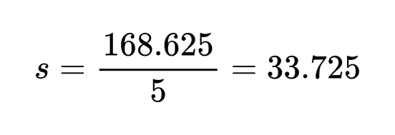
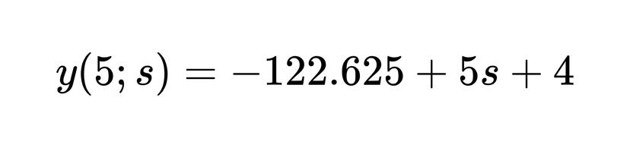
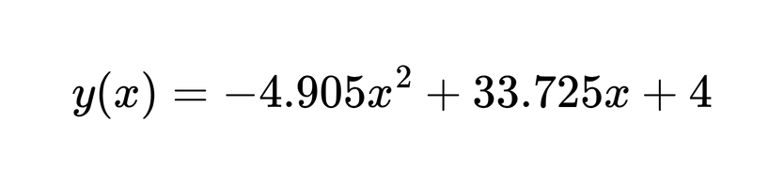
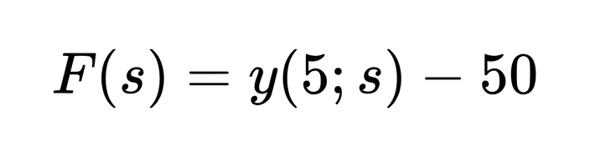
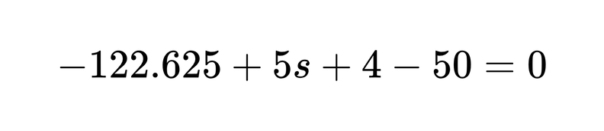
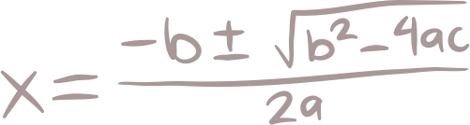
The Shooting Method
Evaluate at x = 5 to form F(s)
Insert x=5:
Final solution with g = 9.81
Boundary target: y(5)=50

Slide 14
Finite difference method

Slide 15
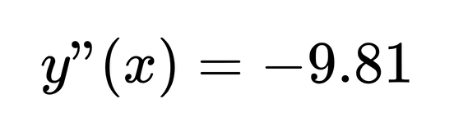
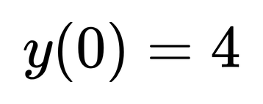
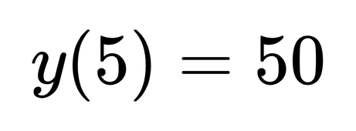
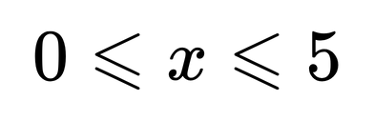
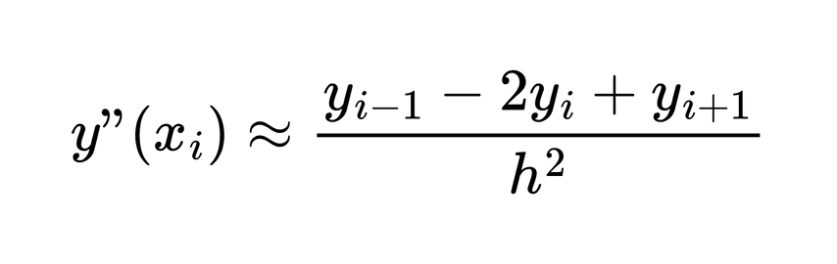
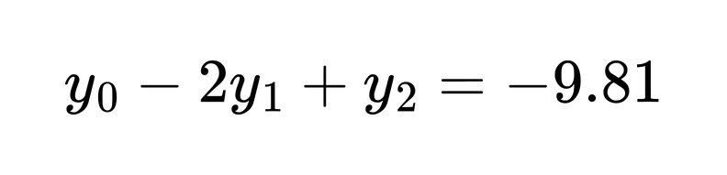
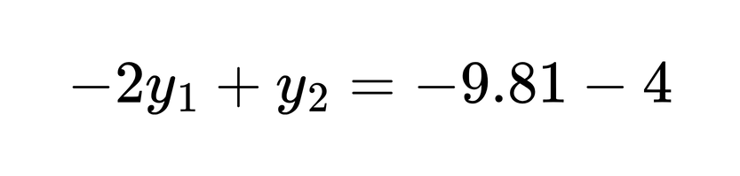
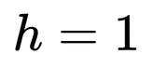
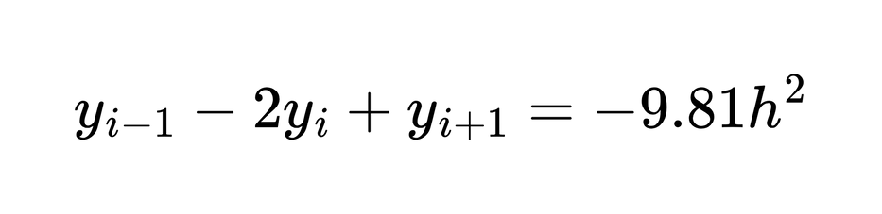
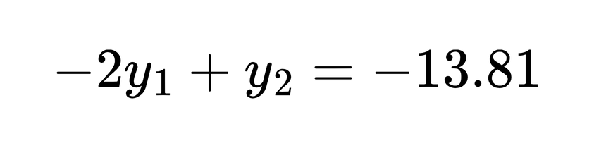
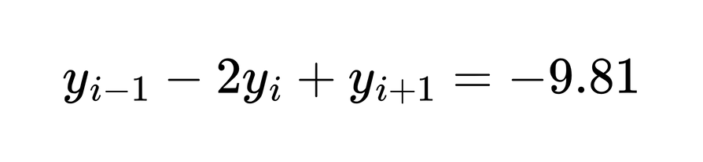
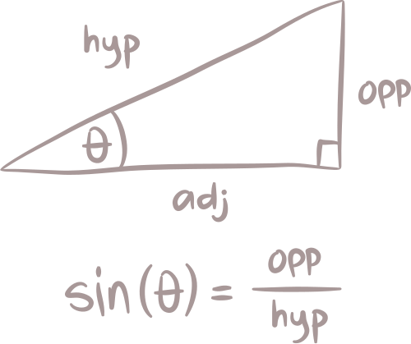
FINITE DIFFERENCE METHOD
finite difference formula:
interior equation:
when i=1
Choose step size:
Substitute y0​=4

Slide 16








FINITE DIFFERENCE METHOD
i=2
Form the tridiagonal
i=3
i=4
Solve the system
Substitute y5​=50:
Full finite difference solution:

Slide 17

solution for shooting
Runge-Kutta 4

Slide 18


solution for shooting
Secant Shooting

Slide 19


solution for shooting
Results (RK4 + Secant shooting)
We have a very small error, both in slope and computed y by RK4 which indicates that this method converged accurately

Slide 20


solution for Finite Diff.
Again, we have a very small error in computed y by Finite Difference which indicates that this method converged accurately

Slide 21
Summary
Ordinary differential equations (ODEs) are equations that relate a function to its derivatives, and initial value problems are a specific kind of ODE solving problem.
Most initial value problems cannot be integrated explicitly and therefore require numerical solutions.
There are methods such as root finding and shooting to solve ODE BVP numerically.
The accuracy of the scheme used depends on its order of approximation of the ODE.
The stability of the scheme used depends on the ODE, the scheme, and the choice of the integration parameters.

Slide 22





THANK
YOu

